Slide 1
Nuclear Fuel Performance
NE-533
Spring 2024

Slide 2
Last Time
Dr. Larry Aagesen spoke about phase field simulations for nuclear fuel performance modeling
Exploring fuel fragmentation of the HBS
Developing new models for fission gas swelling and release of metallic fuels
Utilizing mechanistic, lower length scale, modeling tools to inform engineering scale fuel performance simulations
Thanks for turning in MOOSE project
Problem sessions and short lecture today; Exam on Thursday

Slide 3
UO2 Radiation effects

Slide 4
Thermal Conductivity Degradation
The physical effects caused by atomic displacements are rather complex and depend on the relative sink strengths of a given material for interstitials and vacancies and on the temperature
The defects that survive migrate through the crystal lattice where they cluster to form extended defects like dislocation loops, lines and networks, which can potentially be absorbed in grain boundaries, gas bubbles or precipitates, which act as sinks
Damage by fission also leads to changes in chemistry due to production of fission products
One of the major effects of defect formation is the degradation of thermal diffusivity, due to phonon scattering
Results obtained on irradiated UO2 show that the thermal conductivity is decreasing with increasing burn-up, and that at equal burn-up, samples with higher irradiation temperatures have higher thermal conductivity

Slide 5
Thermal Conductivity Degradation
There are mesoscopic and atomistic features that affect the thermal conductivity
The porosity existing in fresh fuels evolves during irradiation and has a strong impact on heat transport, because voids/bubbles have significantly lower kth than the lattice
Precipitates are formed by fission products that are insoluble in the UO2 lattice, forming oxide or metallic inclusions: can use composite theory to get effective thermal conductivities; typically, these precipitates INCREASE the thermal conductivity of the fuel
Actinides, rare earths, and transition metals can form mixed oxides with UO2 (soluble fission products): these atoms act as phonon scattering centers as a result of the differences in bonding, radii, or mass, and thus decrease kth
Volatile fission products/gases are partially in solution and partially in bubbles, where they act as phonon scatterers or as low kth composite fractions
Point defects and extended defects contribute to the degradation of the thermal conductivity by scattering or limiting the mean free path of the phonons

Slide 6
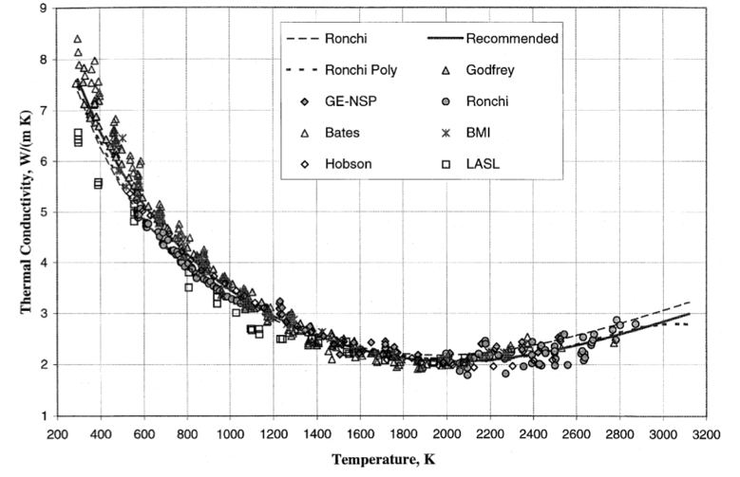
UO2 Thermal Conductivity
We have established correlations for thermal conductivity of fresh UO2 fuel as a function of temperature
Where t = T/1000
The first part of the equation describes the phonon interactions
The second part describes electronic transport which becomes significant at high temperature

Slide 7
UO2 Thermal Conductivity
UO₂ thermal conductivity is low and decreases more during reactor operation
The thermal conductivity has been collected after various amounts of burnup to make empirical fits

Slide 8
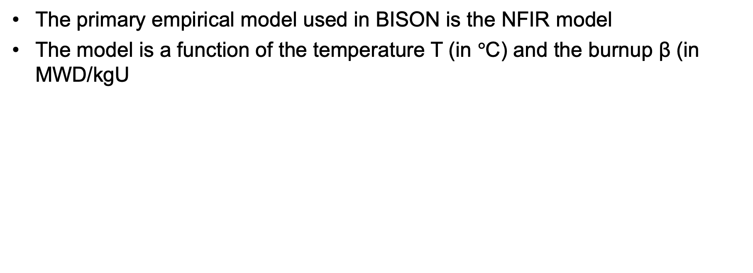
UO2 Thermal Conductivity
The primary empirical model used in BISON is the NFIR model
The model is a function of the temperature T (in $°$C) and the burnup β (in MWD/kgU

Slide 9
UO2 Thermal Conductivity
The R_{f} function switches between two k_{ph} functions

Slide 10
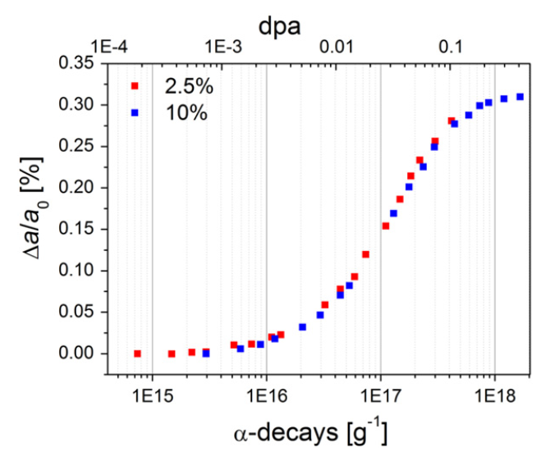
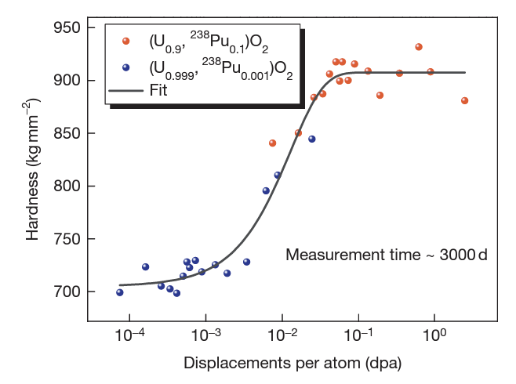
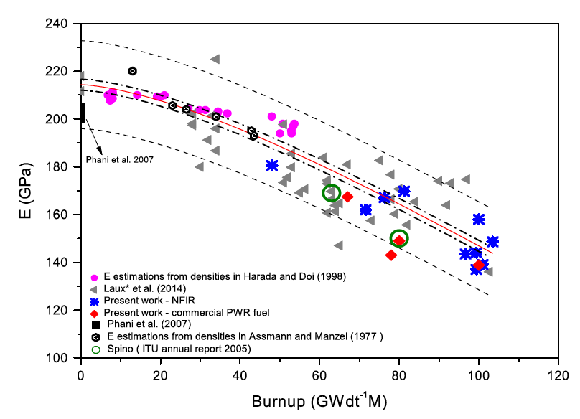
Physical Changes
An important effect of radiation damage is the volume increase of the crystal lattice, leading to macroscopic swelling of the fuel material
Alpha particle damage alone can cause approximately 0.4% swelling
Mechanical properties also vary with damage, increasing with dpa
UO2 does not become amorphous, but damage accumulation can eventually cause polygonization: transformed into a material consisting of very small grains

Slide 11
High Burnup Structure (HBS)
In the late 1950s, it was observed that a strong capture of neutrons by U-238 in the resonance range occurs at the periphery of the fuel
This leads to the production of Pu-239, and leads to a higher fissile density and thus an increase in the local burnup
This high local burnup area is on the outer ring of the fuel and is about 200 microns thick, which represents about 8% of the fuel
This leads to microstructure changes…

Slide 12
High Burnup Structure (HBS)
When thermal recovery is not sufficiently efficient (at lower temperatures), the accumulation of defects at high burnup can lead to the instability of the crystalline structure, initiating a restructuring driven by the energy stored in the material
In UO2, grains subdivide from 10microns in size to 100-200 nm size, and a densely porous structure is formed (~20% porosity)

Slide 13
High Burnup Structure (HBS)
The increase of the relative porosity volume degrades the material conductivity and reduces the mean grain size
On the other hand, the intragranular irradiation defect-cleaning improves the fuel intrinsic thermal conductivity
Fission gas in HBS bubble is retained, not released
Exact mechanism of HBS formation is not understood

Slide 14
Fuel chemistry

Slide 15
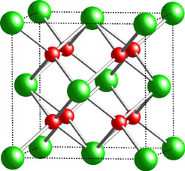
Fuel Chemistry
UO₂ is an ionic compound that must have balanced charges
What is the charge of a typical oxygen ion?
O²⁻
Uranium valance states
Possible: U³⁺, U⁴⁺, U⁵⁺, U⁶⁺
Most stable: U⁴⁺, U⁵⁺, U⁶⁺
Beyond UO2, can have U4O9, U3O8, UO3
The structure is very stable all the way up to the melting temperature and down to extremely low temperatures, even with irradiation damage
There is space in the uranium lattice that can accommodate fission products

Slide 16
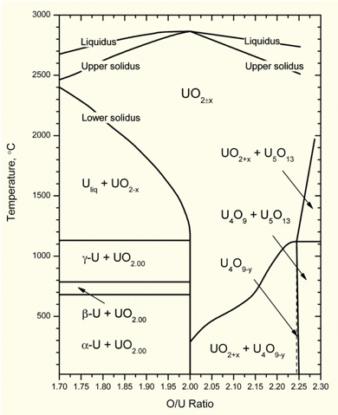
O/M ratio
The ratio of oxygen to uranium metal (O/M ratio) can vary
This is the stoichiometry
The homogeneity range of uranium dioxide extends to both hypo- and hyperstoichiometric compositions in oxygen
The minimum and maximum oxygen contents in the dioxide correspond to the compounds with the formula of respectively UO_{1.67} at 2720 K and UO_{2.25} at approximately 2030 K
Will the O/M ratio go up or down during reactor operation?
It is complicated, because of the formation of fission products that also react with the oxygen, and O interaction with Zr cladding

Slide 17
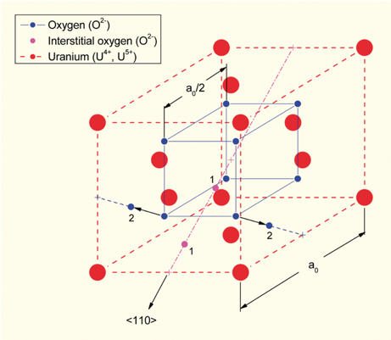
Excess O
The crystal structure of UO₂ can accommodate extra oxygen
Excess oxygen resides at interstitial locations
Oxygen in neighboring sites is displaced
Cation valence increases to maintain electrical neutrality
Fuel fabricated to be nearly stoichiometric; i.e., UO2.00± because:
It is the most stable
It has the highest melting temperature
[after Olander, 1976]

Slide 18
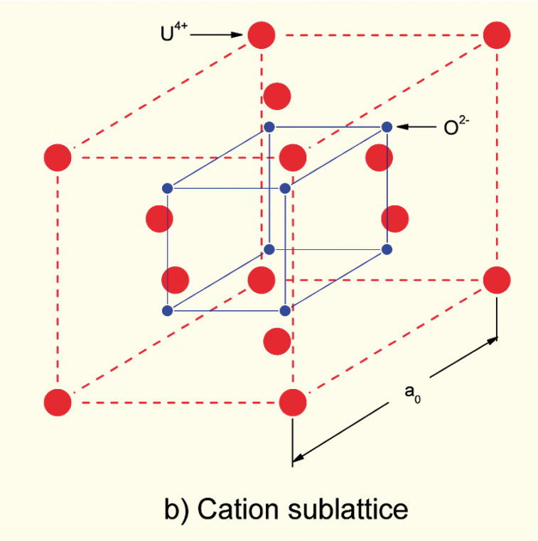
Incorporation of Fission Products
As fission products form, the valence state of the uranium can change
Typical valence of soluble fission products is M³⁺
The uranium valence state changes to compensate
Oxygen liberated by fission
Fission products produced with M³⁺ valance state incorporated in fuel lattice
Uranium oxidizes from U⁴⁺ to U⁵⁺ or U⁶⁺ to maintain local electrical neutrality

